Slide 1
Villa Park Little League Safety Manual 2023
VPLL ID # 04053023
District 30
Safety Officer: Dan Starr

Slide 2
Board of Directors 2023
Jon Whiddon Ryan McArthur Tracy Paul Matt Williams
Andrea Brooks Corbin Hansen Mike Samuel Matt Cairney
Mike Urbanski Charlie Tuggle Joe Pacelli Jordan Czakowski
Andy Olsen Ben Hanna Chad Casenheiser
Brian Pharris Brian Cole Katie Tassos
Jason Walker Jennifer Bergener Jerry Lopez
Jon Brucher Aaron Sadler Lee Tousignant
Mike Urbanksi Dan Starr Todd Thergesen

Slide 3
Introduction
VPLL follows the guidelines and rules set by Little League International and our local District 30 guidelines
VPLL sets local rules for its own teams
Littleleague.org provides extensive and comprehensive information regarding league activities and requirements.
The safety officer attends the annual District 30 safety meeting and provides basic first aid training to managers, coaches, board members, and team parents.
VPLL adheres to Title IX regulations regarding participation
VPLL will upload a completed ASAP, Field Survey, and Roster Data to littleleague.org

Slide 4
Volunteer Application forms
Little League would like 6 completed volunteer application forms submitted for background checks per team per season
Little league uses JDP to process background checks
Visit www.jdp.com for more information regarding this company
They ensure all information is kept encrypted and confidential
Generally, managers, coaches, board members, team parents, umpires, and anyone having contact with players should complete this process

Slide 5
Live Scan
VPLL will conduct annual Live Scan Fingerprinting as part of Little League requirements beginning 2023
Generally managers, coaches, and team parents will be required to complete the Live scan process

Slide 6
Player safety
Child Protection Program update by Little League Org. 2018
Emphasis on the Volunteer Selection Process
New regulations on conduction background checks
Mandatory reporting of child abuse
Proper one on one interaction with minors
Education and training of all volunteers
Emotional Wellbeing and Bullying prevention for players

Slide 7
Accident Reporting
Any injuries occurring on VPLL fields should be reported to the safety officer
The safety officer ill complete an incident report utilizing the littleleague.org provided forms
Injuries to players, volunteers and spectators should all be reported if they warrant anything more than basic first aid
VPLL has its own indemnification policies renewed annually

Slide 8
AED
VPLL has a Zoll AED located in the equipment room adjacent to the Majors field. It is located in the unlocked AED locker on the wall.
The batteries and Pads will be inspected and replaced according to company guidelines
The safety officer can provide instruction on proper usage to anyone interested.
The device functions only to provide defibrillation to appropriate non-perfusing cardiac rhythms (Ventricular Tachycardia and Fibrillation)
This device does not substitute for following appropriate BLS/ACLS guidelines.

Slide 9
Unresponsive Adults
It will be extremely rare for a single person to be present during an event like this on our fields
The most important piece of equipment is the mobile phone to immediately activate 911 services.
General response time will be 5-8 minutes to our fields
Identify yourself as BLS and/or ACLS certified
The most experienced person commands the situation until EMS arrives

Slide 10
Unresponsive adults
Shake patient and yell to see if any purposeful breathing or response
If not, check for a carotid, radial, or femoral pulse for 10 seconds
Almost all adult arrests are cardiac in origin. Airway protection is considered as a secondary issue early in an adult arrest.
Whoever takes the role as “leader” will direct one person to call 911, one person to get the AED device, and one person to provide chest compressions (CPR)
Chest compressions should be “fast and hard” and be 2 inches in depth. You should be exhausted after 2 minutes and require another person to take over.

Slide 11
Unresponsive adult
Stop chest compressions only to quickly apply AED pads and for pulse checks every 2 minutes.
The AED provides automated voice prompts about what to do once turned on.
You should be able to get 100 chest compressions at 2 inches in depth every one minute.
A second provider may position the airway in an appropriate position and deliver 2 rescue breaths after every 30 chest compressions, looking for chest rise. DO NOT stop chest compressions during this time.
DO NOT do anything asked if you are uncomfortable with or unable to complete the requested task. Calling 911 early and beginning chest compressions and getting an AED in place on turned on are the most important steps in achieving return of spontaneous circulation (ROSC).

Slide 12
Unresponsive Pediatric Patients
Extremely rare
Almost always respiratory in nature
Focus on airway and breathing
Players with congenital heart disease should report condition to the safety officer before the season starts
Anyone with PALS or pediatric nursing/MD experience should command the situation until EMS arrives

Slide 13
Bloody Nose (Epistaxis)
Very common
Almost all anterior (nasal septum)
Area is highly vascularized so it can bleed a lot!
Do not put anything inside the nose
Place head forward in a sniffing position and sit patient upright.
Swallowing blood is not good and causes vomiting—bad and gross.
Nasal clamp or firm occlusion by pinching for 10 minutes
This will stop the majority of bleeds
Advanced techniques such as hemostatic packing devices and hemostatic medications can be provided at the CHOC ER if needed.

Slide 14
Facial Injuries
Not very common
The injuries of concern will be eye and dental involvement
Generally, injuries to the periorbital area will cause the classic “black eye”. It is rare for a baseball or accidental bat injury to cause actual injury to the eye. A scrape to the cornea may occur, but fortunately, vision threatening injuries are very uncommon.
Dental injuries to primary (baby) teeth are treated differently than secondary (adult) dental injuries. Any injuries to secondary teeth should prompt emergent evaluation. Look for fractures with bleeding to the tooth, a tooth loose in the socket or one that appears to be sitting in the socket in an inappropriate way.

Slide 15
Dental Injuries
CHOC Emergency Department has pediatric dental specialists available if the attending Emergency Physician identifies an injury requiring urgent attention.
Dental extrusion (the secondary tooth comes completely out of the socket) is a true emergency. The tooth should be handled by the crown only. Do not touch the root. Injury to the supporting periodontal ligament can occur.
Wrap the tooth gently in a saline soaked gauze or even milk. Do not ice immerse. You have about 60-90 minutes to implant the tooth. If qualified to do this procedure it can be done in the out of the hospital setting.

Slide 16
Lacerations
Most lacerations can be treated by primary closure with wound glue or suture
This requires appropriate anesthesia, wound cleansing, and wound exploration provided by most urgent care and Emergency departments.
As an aside, Chapman ER will be closing its services in the near future making St. Joseph and CHOC the truly nearest receiving centers.
CHOC is the ONLY pediatric specialty ER close to the fields.

Slide 17
Heat Related Illness
Exertional Heat related illness in healthy, well-hydrated children is quite rare in the April, May, and June months in our area.
We tend to have moderate temperatures with low humidity making daily Heat Index ratings less concerning
Proper hydration is paramount
Any report of nausea, fatigue, or a player not feeling well should prompt removal from play, placement in a cool/shady environment, administration of fluids, and notification of the BMOD and safety officer.

Slide 18
Climate/Environment associated concerns
Thunder/Lightning should prompt immediate evacuation of field to appropriate shelters
The BMOD will determine play during rain
Cold temperature issues rarely a concern in April-November
Not really climate related but VPLL/Cerro Villa expressly forbids Dogs on the property regardless of size, breed, or whether they are leashed or unleased. If anyone has a dog and will not leave the field please notify the BMOD.

Slide 19
Allergies and Reactive Airway Disease
Most parents are outstanding at knowing how to treat their children with asthma, other respiratory illness, or allergies
VPLL does not keep Epi Pens or Pro Air inhalers on site due to legal concerns and storage issues.
Parents may carry and use these medications on their children as deemed necessary.

Slide 20
Pitcher’s Elbow
Medial (inside portion of elbow) elbow affected
Epicondylitis to ulnar collateral ligament injury (Tommy John surgery)
Any pain should prompt discontinuation of throwing/pitching
Evaluation by a qualified health care person should occur prior to resumption of throwing activities.
Adherence to Pitch count and days rest guidelines are felt to be strongest factors leading to prevention of this condition
Dr. Frank Jobe actually performed the first Tommy John surgery in 1974
It is now being done in younger players and often more than once!

Slide 21
Pitcher’s Elbow
Loss of velocity may be the first sign of an issue and may precede pain or stiffness
Pain is usually maximal during the deceleration phase of arm motion
In adults glenohumeral internal rotation disorder (GIRD) is often the actual cause of elbow pain. It is due to dysfunction of the normal range of motion of the shoulder.

Slide 22
Sprains, Strains, and Overuse Injuries
Common in all ages
Can affect almost any musculoskeletal site
Usually responds to conservative measures including rest, icing, proper compression devices and acetaminophen and/or NSAIDs like Ibuprofen
Physical therapy may be necessary for lingering injuries

Slide 23
Concussion
Has become a huge focus in sporting related injuries
Fortunately, true concussions in baseball are uncommon and less common in youth baseball at the little league level
Football Players, Hockey players, and female volleyball players are at highest risk on the collegiate level
Only 10% of concussions result in loss of consciousness
No imaging test or physical exam sign can reliably diagnose or exclude a concussion
Generally, a player is cleared to play only after ALL symptoms have resolved during any activity.

Slide 24
COVID-19
VPLL will adhere to and update COVID-19 related protocols as necessary
Currently, masking and proper physical distancing will be enforced for spectators
Anyone with symptoms of illness should not be on the fields.
Please notify the safety officer if any player/manager/coach/league official develops COVID type symptoms.

Slide 25
Pre-Game Safety
Fields will be maintained in accordance with little league and local municipality guidelines for safe play
Pre-Game
Manager/Coach may use wiffle type ball for warm ups in the outfield for batting
One batter at a time with helmet
Catcher must where catcher mask if in the bullpen with a pitcher
All players must wear a cup
All players must have appropriate cleats
All players must have USA bat and a helmet. Umpire will inspect before games

Slide 26
Game Safety
Only the player batting may be handling a bat
NO on deck warm ups anywhere (field, bullpen, dugouts, etc..)
No climbing fences or standing on the dugout benches
Coaches may not warm up their pitchers
No head first sliding
No running into the catcher
Adhere to pitch count/days rest guidelines

Slide 27
2021 Volunteer Application form

Slide 28
Out of hospital bls algorithm

Slide 29
Pediatric bls algorithm

Slide 30
Heat index chart

Slide 31
Heads up concussion protocol

Slide 32
Zoll aed plus

Slide 33
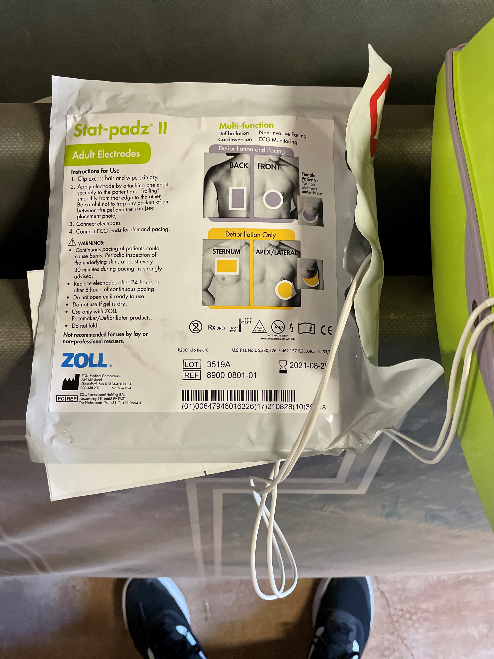
ZOLL AED PLUS

